Slide 1

Find your dream bike with JobRad®
Your employer leases the bicycle of your choice.
You can ride it whenever you want – to work, in your spare time, on holiday or for sport.
[company logo]

Slide 2

Choose the perfect bicycle for you – all types and brands

Slide 3
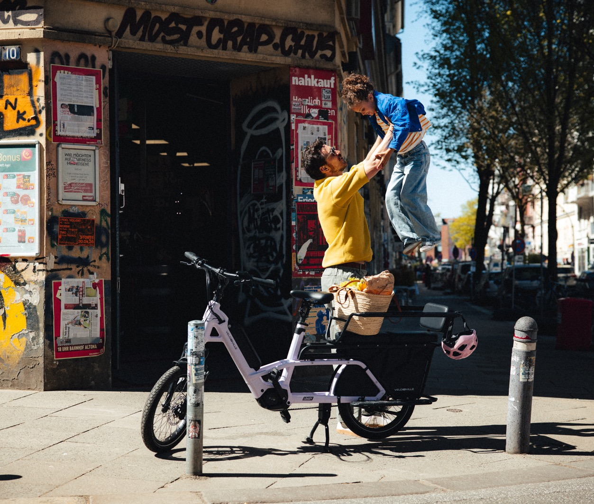
Save up to 40 % compared with direct purchase!

Slide 4
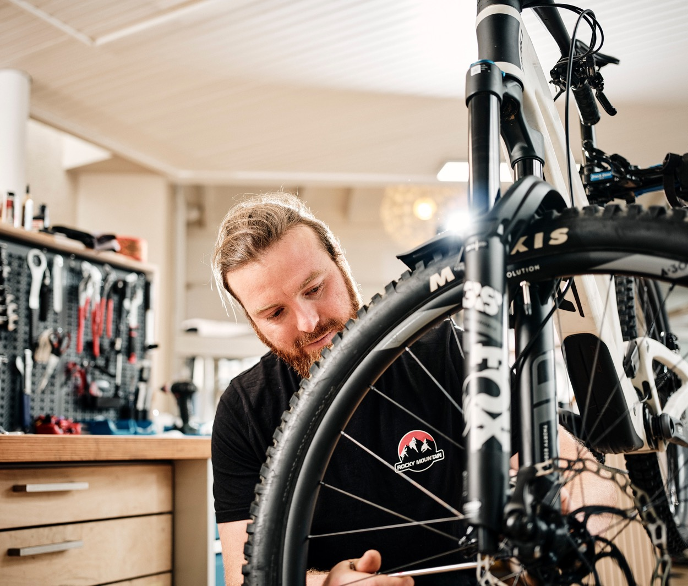

Perfectly equipped thanks to fully comprehensive insurance and repair services

Slide 5

Life is a beautiful ride.
Create an account on the JobRad®-Portal now and apply for your dream bike!
Feel free to contact:
[place e-mail address]
269-01.2026
[company logo]

